Slide 1
Lecture 4 Module 1
Dart I/O,Classes ,Constructors-default ,parameterized,

Slide 2
Dart – Standard Input Output
Standard Input in Dart:
.readLineSync() method to read
To take input from the console you need to import a library, named dart:io from libraries of Dart.
Standard Output in Dart:
In dart, there are two ways to display output in the console:
Using print statement.
Using stdout.write() statement.
The print() statement brings the cursor to next line while stdout.write() don’t bring the cursor to the next line, it remains in the same line.

Slide 3
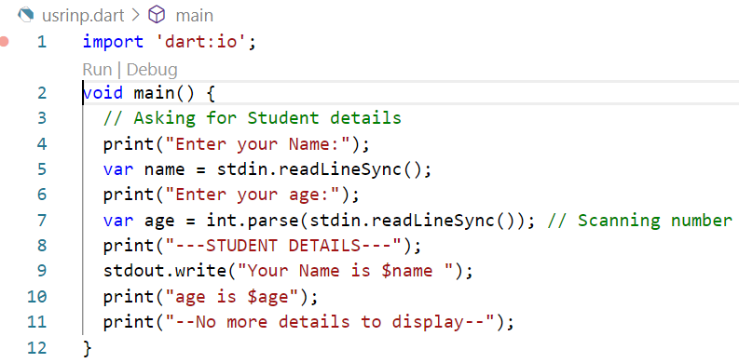
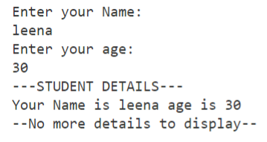
Console input/output

Slide 4
Classes and objects
Class and objects
Default Constructor
Parameterized Constructor
Named Constructor

Slide 5
Classes and objects
Cascade notation:
The following creates the p1 object and assigns its properties to values:
var p1 = Point();
p1.x = 10;
p1.y = 20;
In this example, the p1 object is repeated multiple times, each for an assignment. To make it more concise, Dart provides a cascade operator (..) that allows you to chain multiple assignments on the same object without repeating the object name. For example:
class Point {
int x = 0;
int y = 0;
}
void main() {
var p1 = Point()
..x = 10
..y = 20;
}
Cascade Notation

Slide 6
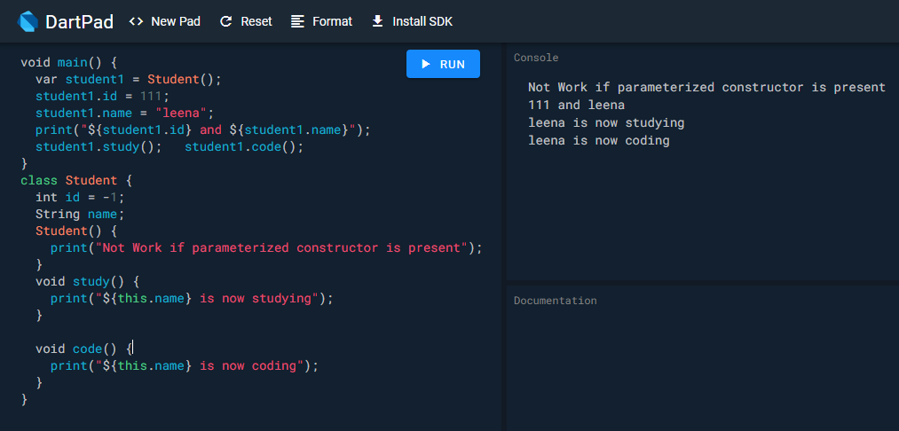
Default Constructor

Slide 7
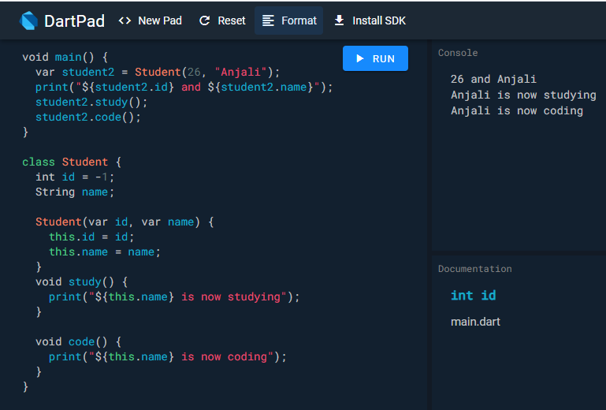
Parameterized constructor

Slide 8
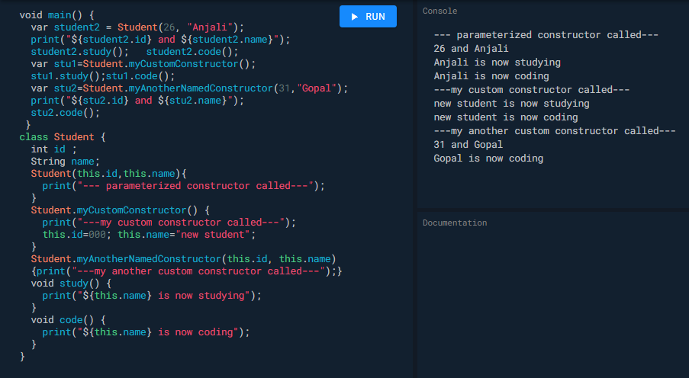
Named or Custom Constructors
Named Constructor: As you can’t define multiple constructors with the same name, named constructor is the solution to the problem. They allow the user to make multiple constructors with a different name.

Slide 9
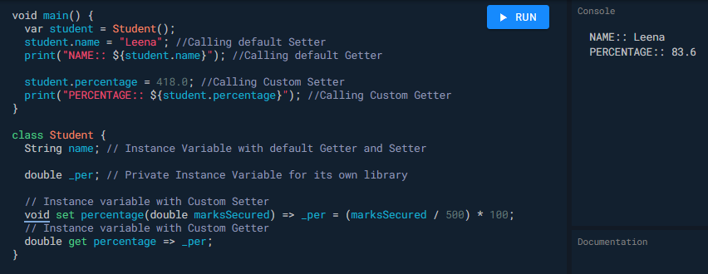
getter/setter in dart

Slide 10
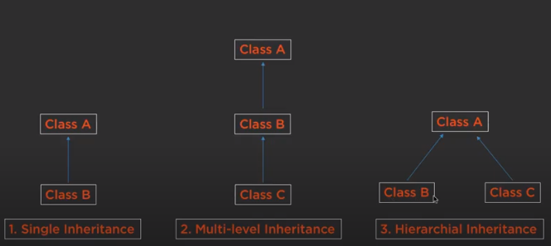
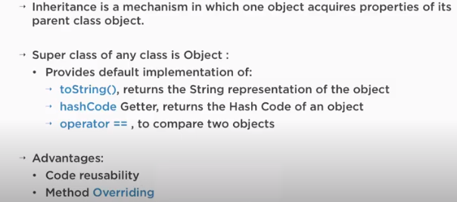
Inheritance

Slide 11
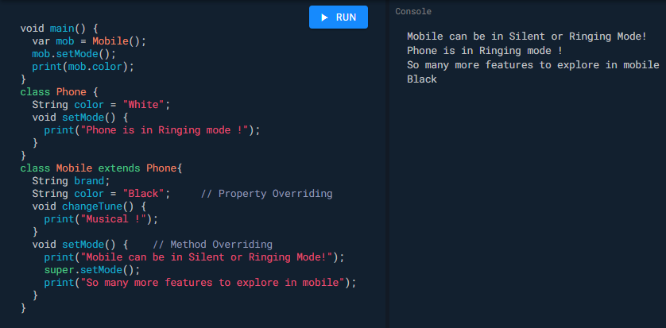
Method Overriding in Inheritance

Slide 12

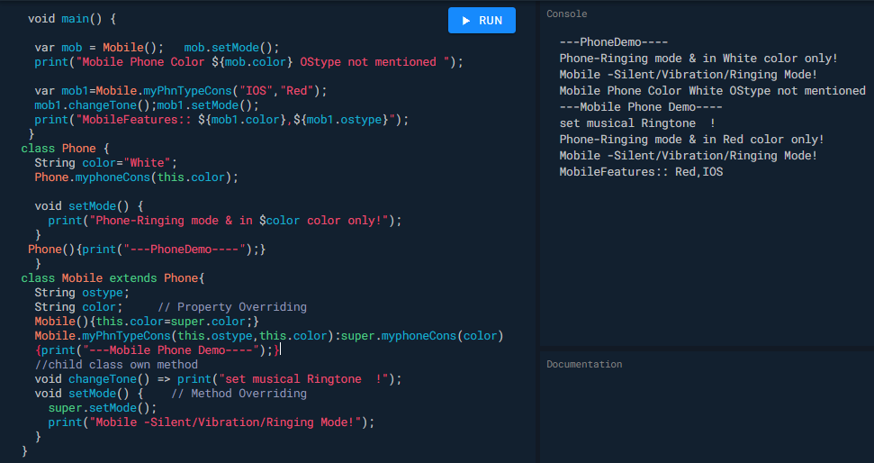
Constructors in Inheritance

Slide 13
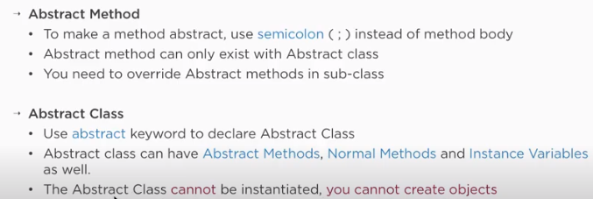
Abstract Methods and Class

Slide 14
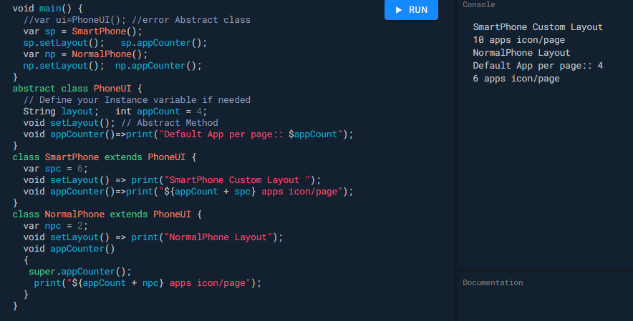
Abstract Methods and Class

Slide 15
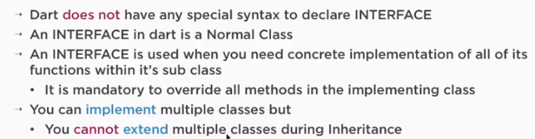
Interface

Slide 16
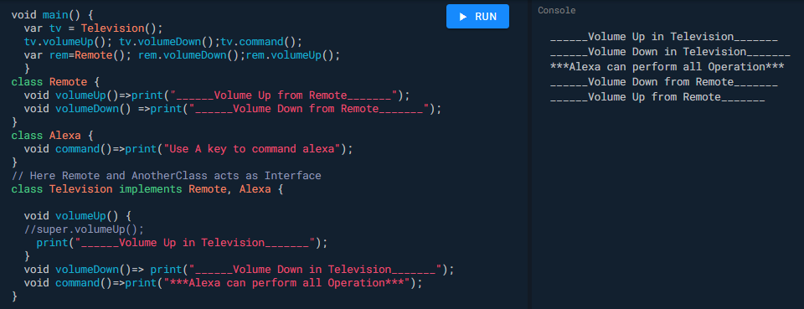
Interface Example

Slide 17
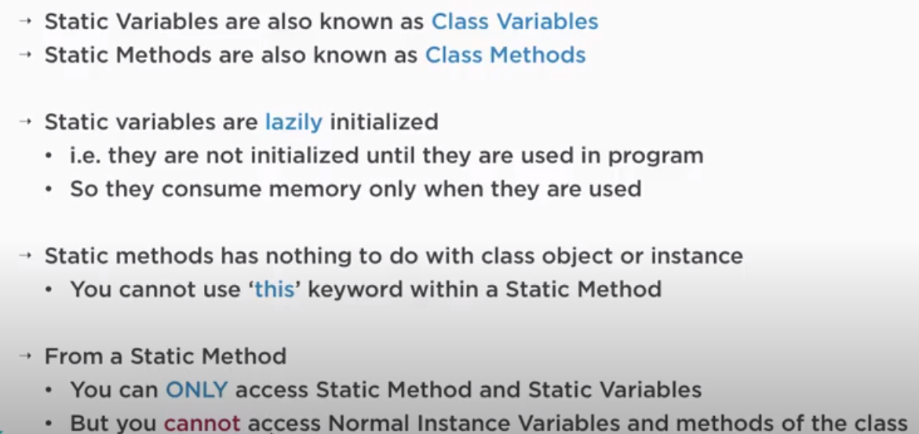
Static keyword in dart

Slide 18
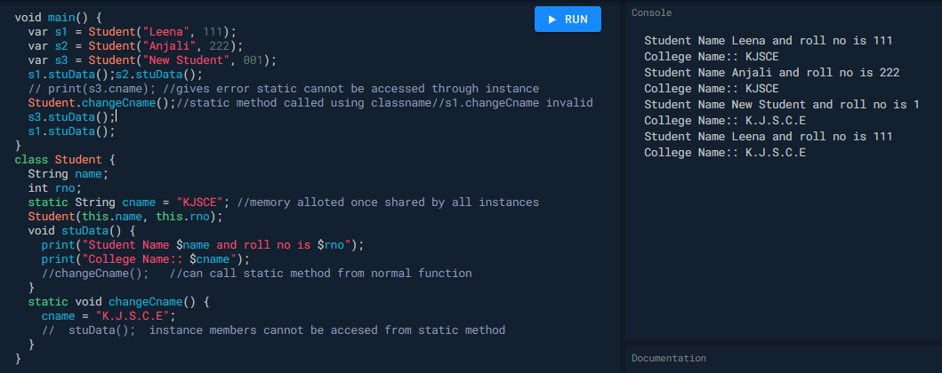
Static Example

